Slide 1
Lecture 2
Intuition to Machine Learning

Slide 2
Recall
Regression
Linear Regression
Hypothesis
Cost Function
Gradient Descent
Assignment

Slide 3
Today
Some other types of Regression
Logistic Regression
Classification task
Assignment

Slide 4
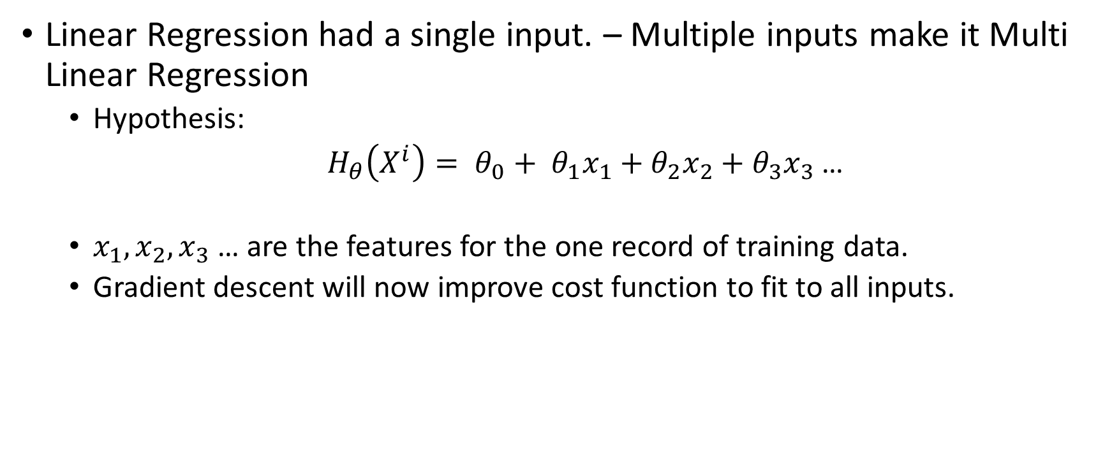
Other types – Multi Linear Regression
Linear Regression had a single input. – Multiple inputs make it Multi Linear Regression
Hypothesis:
$H_{θ}\left(X^{i}\right)= θ_{0}+ θ_{1}x_{1}+θ_{2}x_{2}+θ_{3}x_{3}$ …
$x_{1},x_{2},x_{3}$ … are the features for the one record of training data.
Gradient descent will now improve cost function to fit to all inputs.

Slide 5
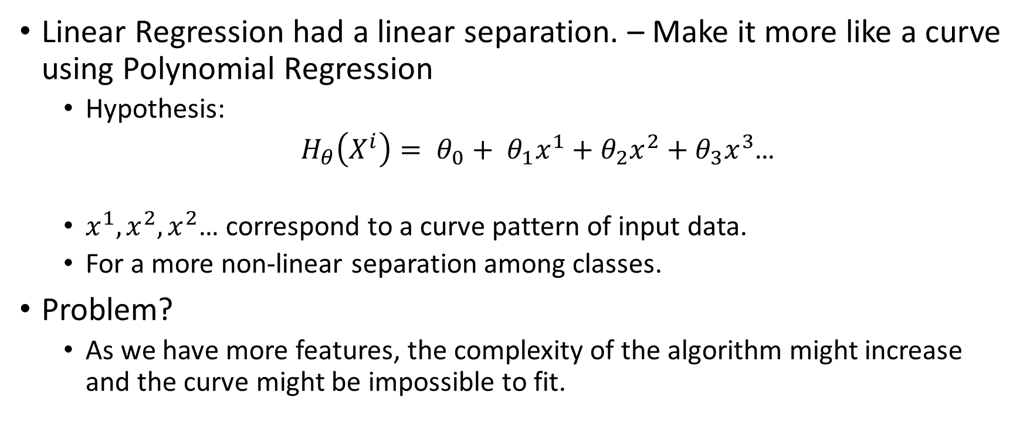
Other types – Polynomial Regression
Linear Regression had a linear separation. – Make it more like a curve using Polynomial Regression
Hypothesis:
$H_{θ}\left(X^{i}\right)= θ_{0}+ θ_{1}x^{1}+θ_{2}x^{2}+θ_{3}x^{3}$…
$x^{1},x^{2},x^{2}$… correspond to a curve pattern of input data.
For a more non-linear separation among classes.
Problem?
As we have more features, the complexity of the algorithm might increase and the curve might be impossible to fit.

Slide 6
Logistic Regression
Solves the problem in Polynomial Regression
Attempts to make the curve non-linear using a simple add-on function on the Linear Regression.
Sigmoid Function

Slide 7
Sigmoid Function

Slide 8
Visualise
What we saw: inputs X mapped with their corresponding outputs Y
What machine sees: inputs X with their outputs Y in a file
What we/machines have to do ?: Form a relation between the inputs and outputs so that we can get predictions for future outputs.

Slide 9
Hypothesis
The main task of the machine will be to predict the output
How to represent that relation ?

Slide 10
Hypothesis
Graph here

Slide 11
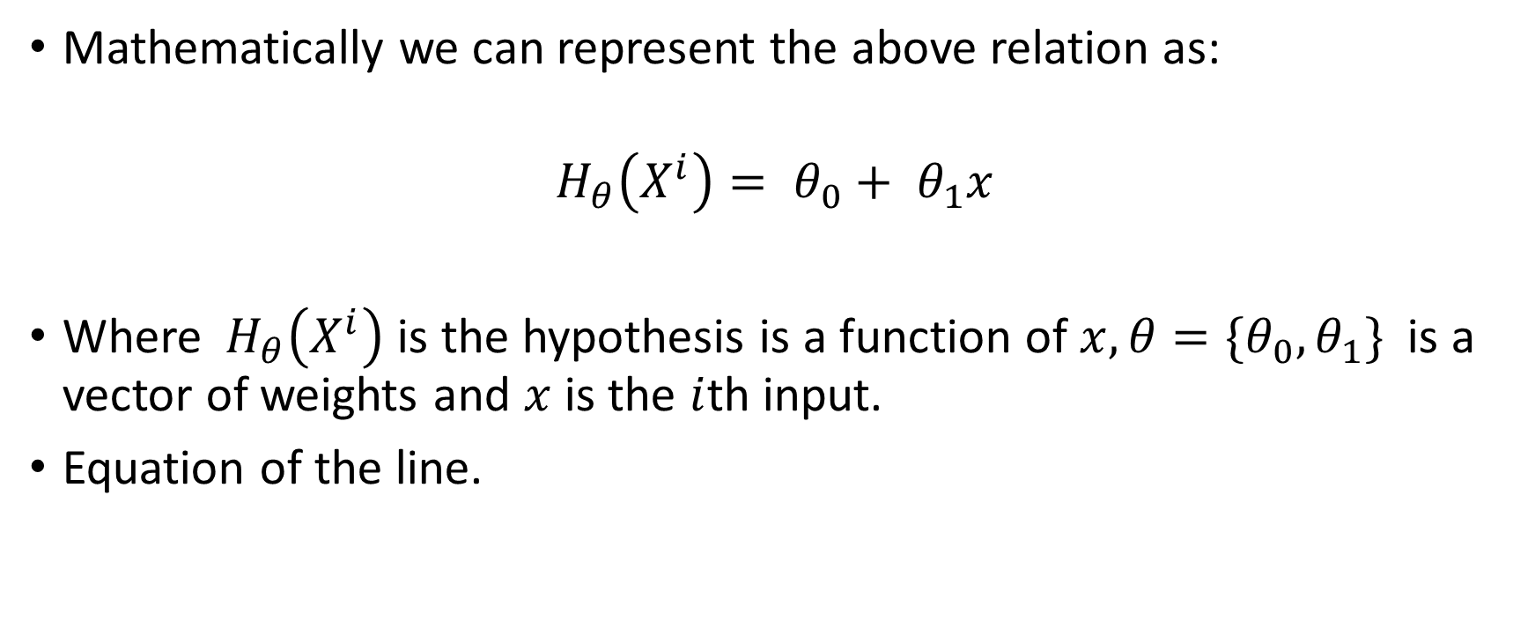
Hypothesis
Mathematically we can represent the above relation as:
$$H_{θ}\left(X^{i}\right)= θ_{0}+ θ_{1}x$$
Where${ H}_{θ}\left(X^{i}\right)$ is the hypothesis is a function of $x, θ={\{θ}_{0},θ_{1}\}$ is a vector of weights and $x$ is the $i$th input.
Equation of the line.

Slide 12
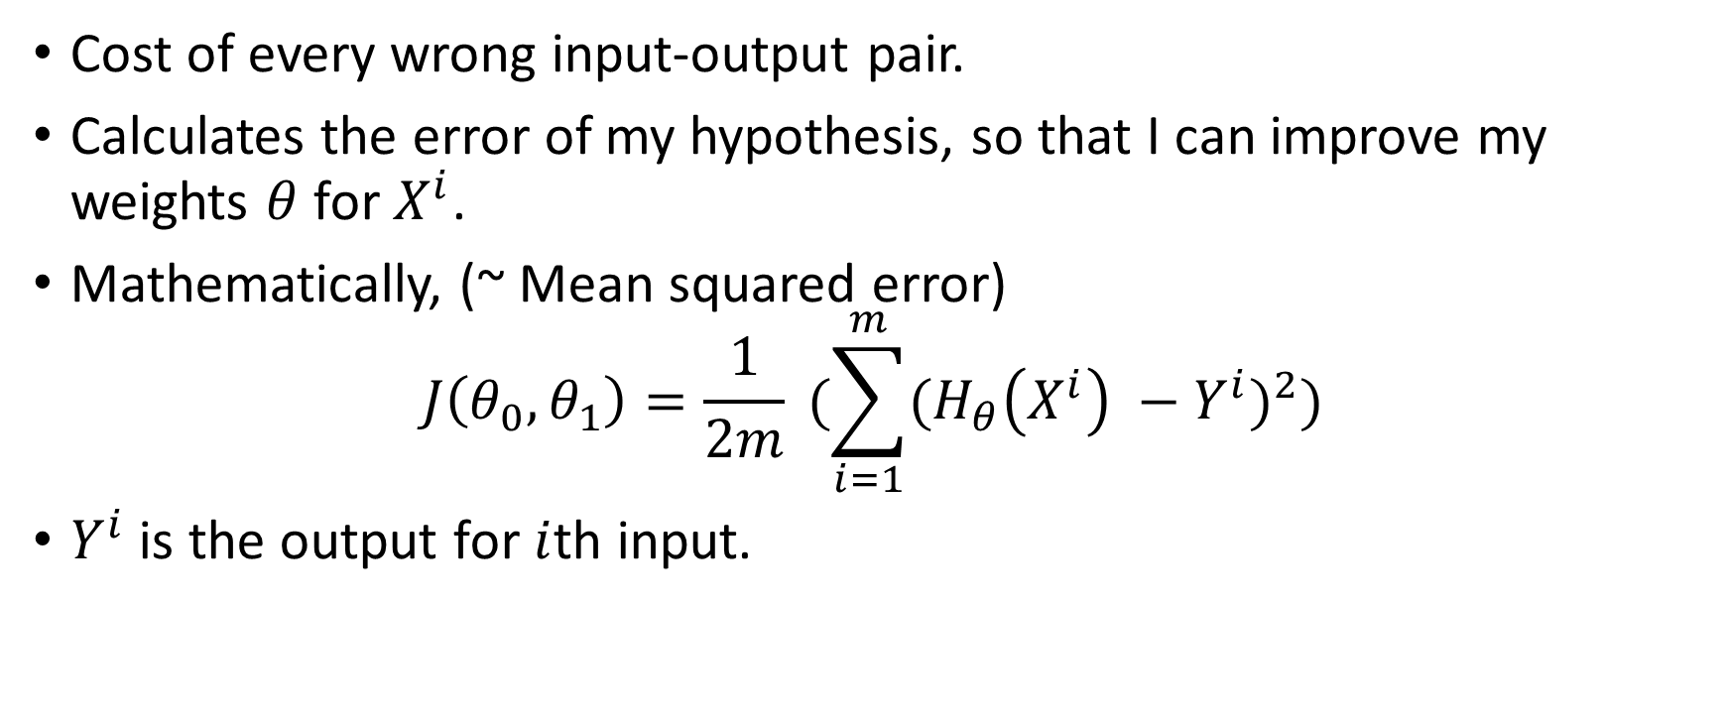
Cost Function
Cost of every wrong input-output pair.
Calculates the error of my hypothesis, so that I can improve my weights $θ$ for $X^{i}$.
Mathematically, (~ Mean squared error)
$$J\left(θ_{0},θ_{1}\right)=\frac{1}{2m} (\sum_{i=1}^{m}{{(H_{θ}\left(X^{i}\right) −Y^{i})}^{2}})$$
$Y^{i}$ is the output for $i$th input.

Slide 13
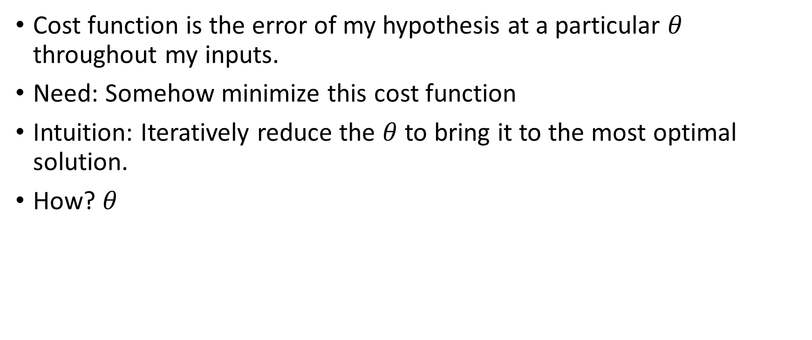
Cost Function
Cost function is the error of my hypothesis at a particular $θ$ throughout my inputs.
Need: Somehow minimize this cost function
Intuition: Iteratively reduce the $θ$ to bring it to the most optimal solution.
How? $θ$

Slide 14
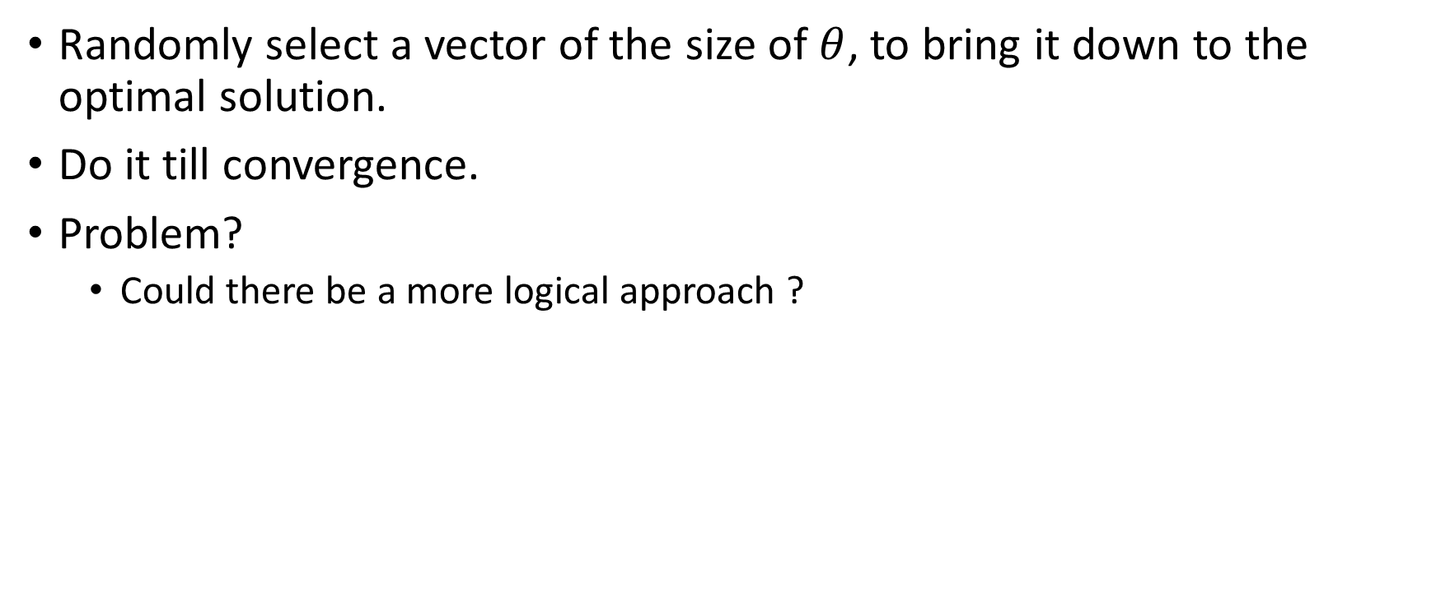
Random Iterative Descent
Randomly select a vector of the size of $θ$, to bring it down to the optimal solution.
Do it till convergence.
Problem?
Could there be a more logical approach ?

Slide 15

Numerical Descent
Use the partial derivative of each of $θ$.
Derivative = slope, and we just need to get to slope = 0.
Gradient Descent.

Slide 16
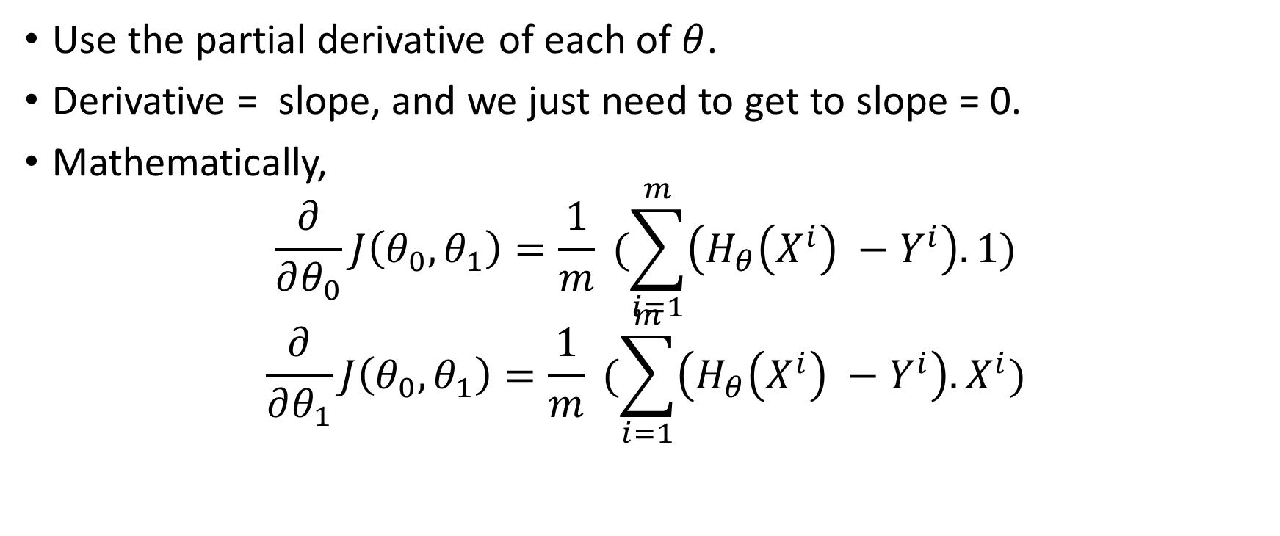
Numerical Descent
Use the partial derivative of each of $θ$.
Derivative = slope, and we just need to get to slope = 0.
Mathematically,
$$\frac{∂}{∂θ_{0}}J\left(θ_{0},θ_{1}\right)=\frac{1}{m} (\sum_{i=1}^{m}{\left(H_{θ}\left(X^{i}\right) −Y^{i}\right).1})$$
$$\frac{∂}{∂θ_{1}}J\left(θ_{0},θ_{1}\right)=\frac{1}{m} (\sum_{i=1}^{m}{\left(H_{θ}\left(X^{i}\right) −Y^{i}\right).X^{i}})$$

Slide 17

Gradient Descent
$$repeat till convergence\{$$
$$θ_{j}=θ_{j} − α\frac{∂}{∂θ_{j}}J\left(θ_{0},θ_{1}\right)$$
$$\}$$
$α$ = step-size / Learning Rate

Slide 18
Visualize
Contour Plot here.

Slide 19
Assignment
Computationally implement all the functions:
Hypothesis
Cost function
Gradient Descent

